Slide 1
PCORnet®:
An Introduction
PCORnet® is intended to improve the nation’s capacity to efficiently conduct patient-centered health research, particularly comparative clinical effectiveness research (CER), by providing a large, highly representative network of health data, research expertise, and patient insights. PCORnet has been developed with funding from the Patient-Centered Outcomes Research Institute® (PCORI®).
Updated May 2025

Slide 2






Unite Data and Communities for Faster, More Targeted Research
Providers and researchers
EHRs, claims, and patient-reported data
One PCORnet®, Many Possibilities
-----------------------------------------------------------
PCORnet is a network, funded by PCORI, that enables insights from high-quality health data, patient partnership, and research expertise to deliver fast, trustworthy answers that advance health outcomes.
Real-world evidence studies
Comparative clinical effectiveness research
Population health research
Pragmatic research
Health systems research
And more
With national-scale collaboration built in, PCORnet functions as a learning health system to help researchers surface answers.
More Than a Data Network
-----------------------------------------------------------
Access to patient partners and thousands of clinicians with expert knowledge of PCORnet-enabled data = meaningful research targets and faster answers.
Patients, caregivers, and advocates

Slide 3
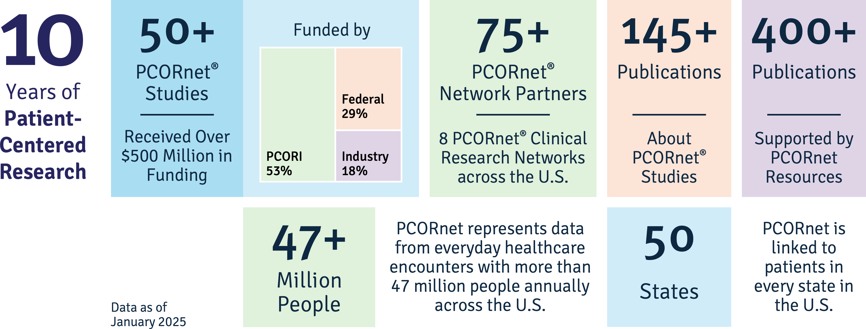
A Vetted National Resource
PCORnet® Studies have already answered major patient-centered clinical comparative effectiveness research questions on heart disease, metabolic and renal disorders, obesity, and more, leading to meaningful improvements in patient care.
Research that leverages this network is tapping into a proven engine for discovery.

Slide 4
Data Insights via PCORnet®

Slide 5
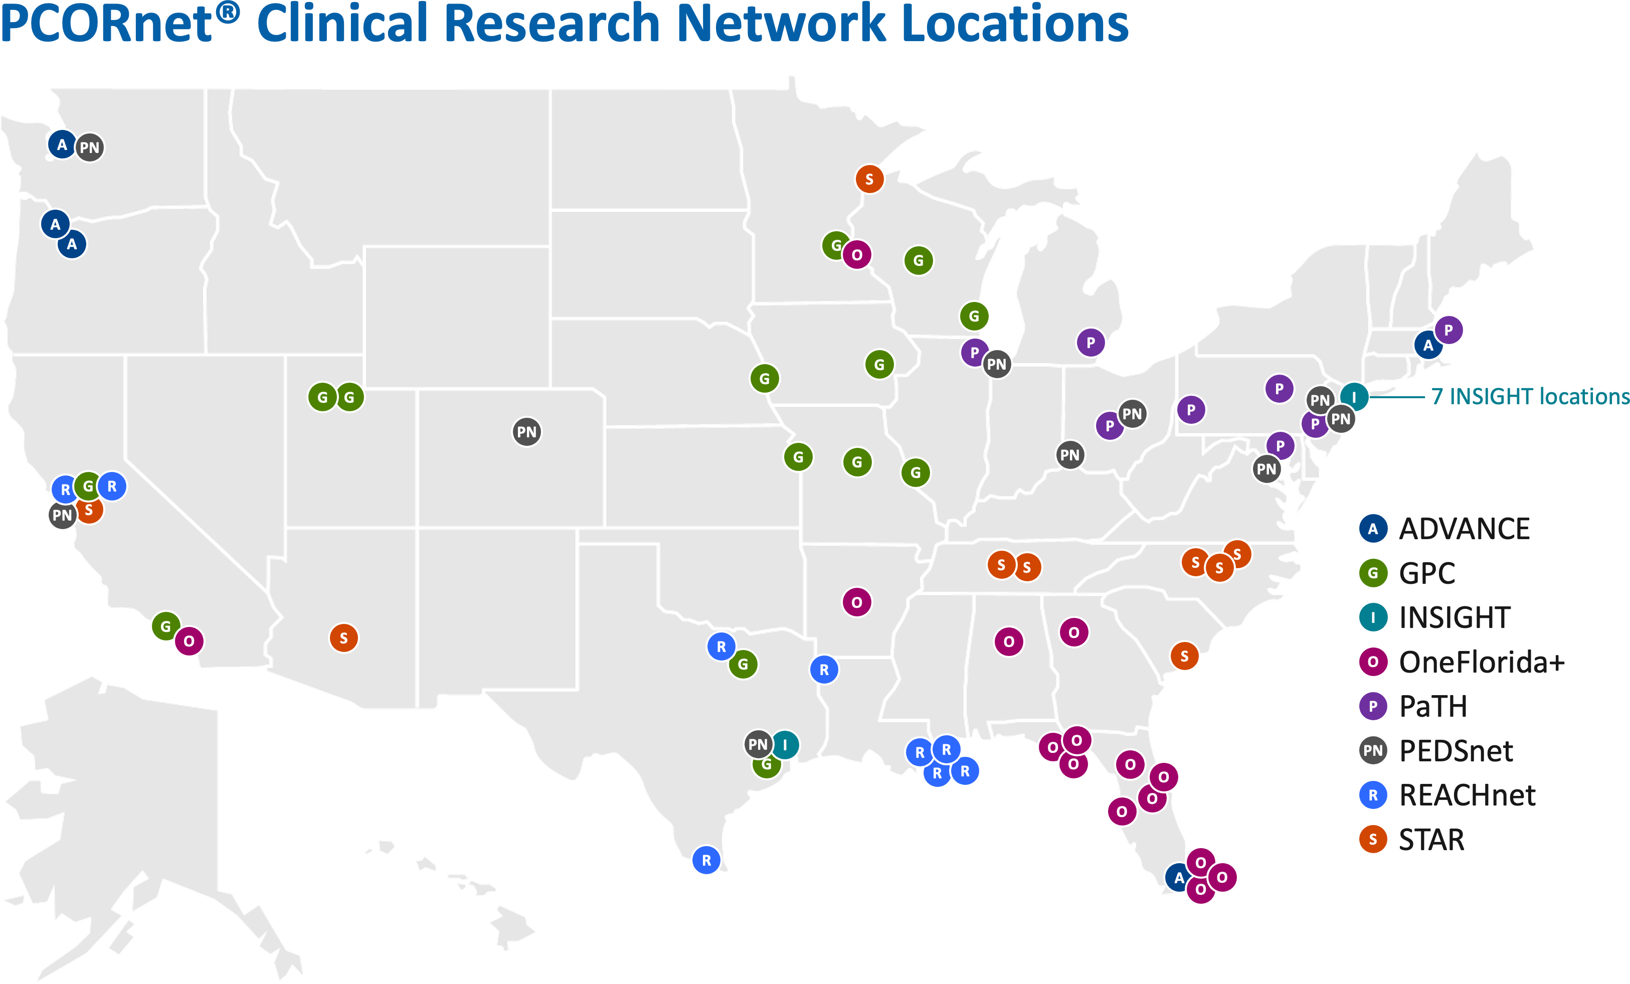
PCORnet® Clinical Research Network Locations The PCORnet infrastructure offers access to real-world data through partnerships with Clinical Research Networks (CRNs)
What are Clinical Research Networks?
PCORnet® CRNs are groups of healthcare institutions across the U.S., from large academic health centers to local community clinics, united by a commitment to speed patient-centered research via PCORnet.
5

Slide 6
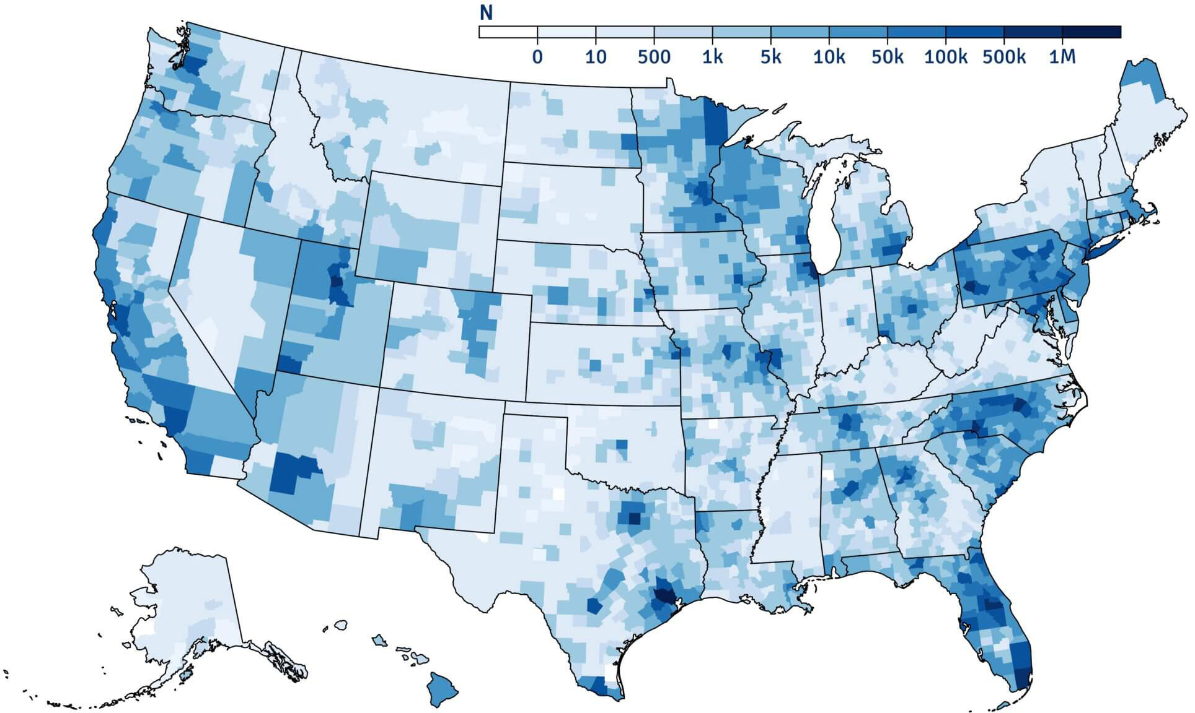
Scope of PCORnet-Accessible Data
PCORnet represents data from everyday health care encounters with more than 47 million people annually across the U.S.
*The data density map illustrates single addresses that are associated with individual PCORnet® Network Partner encounters.
6

Slide 7


The PCORnet® Common Data Model
For data to be useful, it has to be standardized across systems. Frequent data curation and a single language enabled by the PCORnet® Common Data Model (CDM) deliver fast insights.
Ready for Research
Available, But Still Evolving
Demographics
Diagnoses
Procedures
Immunizations Tumor Registry Biosamples
Vital Signs
Clinical Observations
Social Determinants of Health
Patient-Generated Data
Genomic Results
Labs
Medication Orders & Administrations
Patient-Reported Outcomes
Natural Language Processing Derived Concepts
Data from PCORnet® Clinical Research Networks available in the PCORnet® CDM and ready for use in research
Data available at some PCORnet® Clinical Research Networks, may or may not be in the PCORnet® CDM and require additional work for use in research
7

Slide 8
Community Engagement via PCORnet®

Slide 9
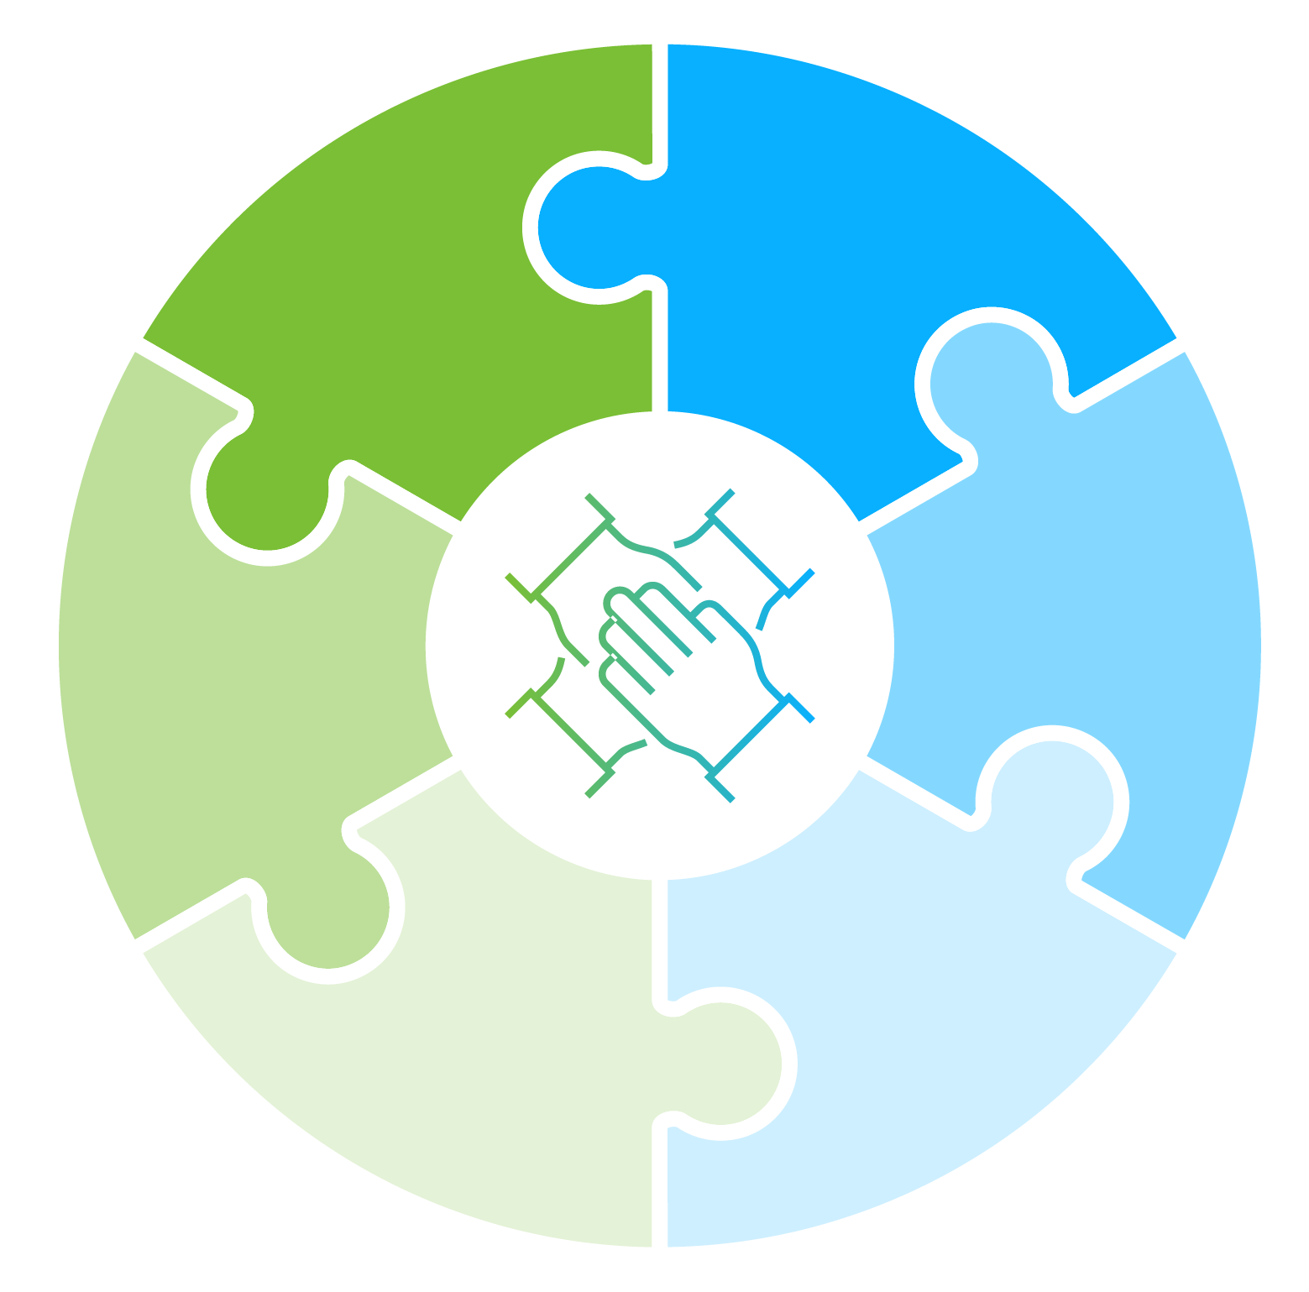
Engaged Communities Drive Better, Faster Research
Support with patient recruitment
What do we mean by “communities”?
Patients and caregivers, engaging as coequal collaborators with health professionals
Clinicians/Clinic Staff
Insurers
Policymakers
Others
Context of lived
experience
Feedback to lessen study burden on participants
Advice for meaningful endpoints
Best tactics to disseminate
research
findings
“Good studies consider all relevant evidence — and no evidence is more relevant than the community experience.”
— PCORnet® Steering Committee Member
Insights to help reach populations
of interest

Slide 10
PCORnet Compared with Other Research Networks
The PCORnet infrastructure brings a full spectrum of capabilities, plus connection to communities.
PCORnet | Feasibility queries | Identification of patient populations for trial recruitment | Coordinated data curation | Connection to patients and providers
ENACT
TriNetX
OPTUM
OHDSI
Sentinel
= capabilities
= limited capabilities
= lacks capability
10

Slide 11
Work with PCORnet®

Slide 12
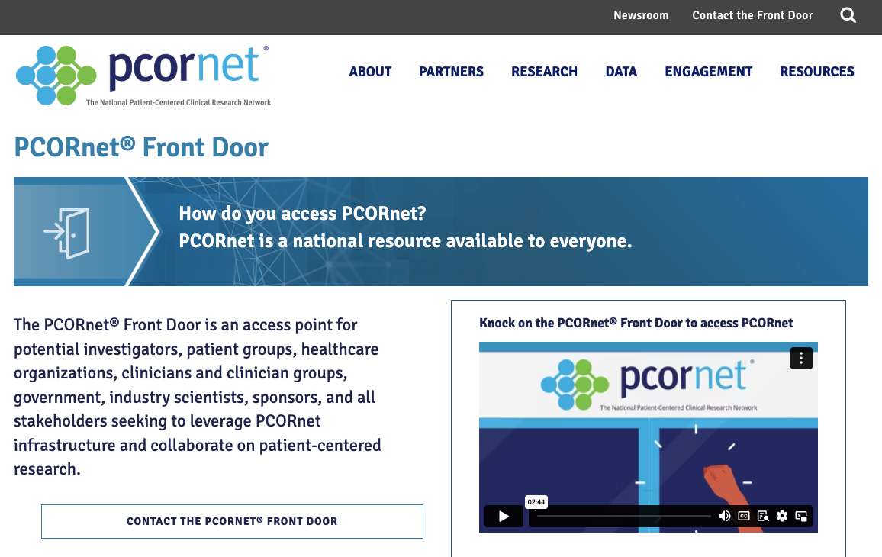
The PCORnet® Front Door
The Front Door is the Access Point for PCORnet Resources & Services
A “knock” on the Front Door can support:
Study Design
Preliminary data for proposals, effect sizes,
and potential study power
Connections to Network Collaborators
Partners to co-design research
People with specific expertise
PCORnet® Study Support
Deeper partnership with PCORnet provides access to best practice sharing, patient engagement, and transparent quality improvement initiatives
Learn More About the Front Door
12

Slide 13
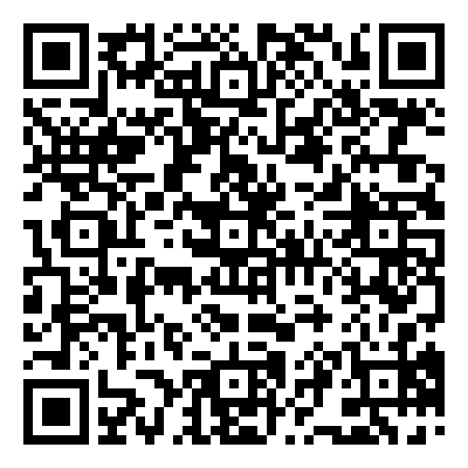


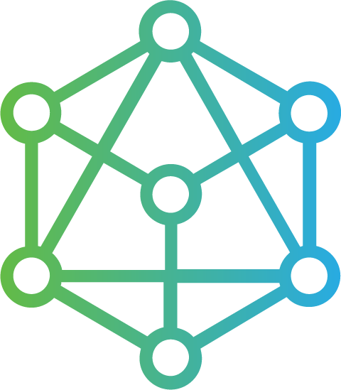

The PCORnet® Front Door
Through the PCORnet® Front Door, we invite potential investigators, patient groups, healthcare organizations, clinicians and clinician groups, government, industry scientists, and sponsors to leverage the unique PCORnet infrastructure and collaborate on patient-centered clinical research.
YOU CAN USE THE PCORnet® FRONT DOOR TO:
Learn how PCORnet can support your work with a Study Feasibility Review
Submit your proposal/study concepts to the Coordinating Center for PCORnet® prior to submitting for funding opportunities to assess if your study is well-suited for the PCORnet infrastructure.
Get data insights from PCORnet® Clinical Research Networks with a Data Network Request
Obtain aggregated results for informing research project development.
Build your study team with a Network Collaborator Request
Connect with expert investigators and patients to collaborate on study planning and implementation.
Lead the future of patient-centered research with a PCORnet® Study Designation Request
Following procurement of study funding, apply to become a PCORnet® Study. PCORnet® Studies enjoy benefits like increased visibility through PCORnet communications channels, shared learning opportunities, and expert support.

Slide 14



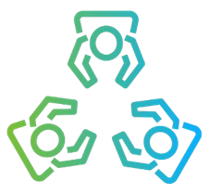
A Secure Infrastructure Makes Real-World Data Accessible
Step 1
The requestor
submits a question through the PCORnet® Front Door
Step 2
The Coordinating Center
for PCORnet® reviews the question and consults with the requestor about
next steps
Step 3
The Coordinating Center converts the request into a query and sends it to PCORnet® Network Partners via a secure web portal
Step 4
PCORnet® Network Partners provide a report, which is sent back through the Coordinating Center to the requestor
Requestor queries are sent to the data — and answers, not data, are sent back to requestors.
Read the Statement on Data Privacy
14

Slide 15
Use Cases

Slide 16
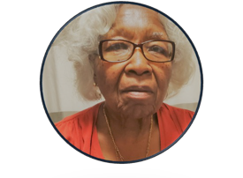
PREVENTABLE
Pragmatic Evaluation of Events and Benefits of Lipid-Lowering in Older Adults
The Question
Can taking a commonly used heart medication prevent dementia in adults over the age of 75?
Study Snapshot
Largest trial to date in people age 75+
Over 9,000 enrolled so far, with a goal to include up to 20,000
Pragmatic design uses existing Medicare and EHR data, plus data from phone surveys. Study drugs are shipped directly to patients.
Strength of PCORnet
A “one-stop shop” for capturing 3 complementary sources of data (Medicare, EHR, & surveys)
“I appreciate that PREVENTABLE is looking at a commonly prescribed drug to see if it could benefit seniors.”
Minnie Jefferson, Patient Advisor
16

Slide 17
PREVENTABLE
Pragmatic Evaluation of Events and Benefits of Lipid-Lowering in Older Adults
IMPACT
Because of the pragmatic trial design, only one protocol amendment was needed to respond to COVID-19
Embedded expertise in PCORnet fueled rapid enrollment of the largest trial in people aged 75+ to date. Broadly promoted via a major newspaper, AARP publications, and local senior guides
Takeaway
PCORnet can effectively support pragmatic studies in challenging populations where there are barriers to participation.
17

Slide 18
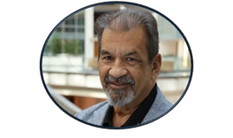
ADAPTABLE
Aspirin Dosing: A Patient-centric Trial Assessing Benefits and Long-term Effectiveness
The Questions
Which aspirin dose offers the right balance of effectiveness and minimal risk of bleeding?
Can PCORnet be used to find the answer using a clinical trial model wherein patients are drivers of engagement?
Strength of PCORnet
Adaptors: Nine patient partners from ADAPTABLE’s clinical research networks:
Offered study guidance
Were embedded at every study step, from study concept to completion and dissemination
Study Snapshot
Pragmatic clinical trial
15,000 patients living with heart disease
Participants randomly assigned to take either 81 mg or 325 mg dose of aspirin
“I have lost three friends to heart disease; I don’t want to lose more.”
Ken Gregorie, Adaptor
18

Slide 19
ADAPTABLE Aspirin Dosing: A Patient-centric Trial Assessing Benefits and Long-term Effectiveness
IMPACT
IMPACT
ADAPTORS CONTRIBUTED TO 3 KEY EFFORTS
Newsletter for Enrolled Patients:
Quarterly, included study updates plus patients’ personal stories
493 participants have shared their personal story to date
Study Communication:
Revised study materials
to make them easier to understand for patients and coached study teams
in mock calls to potential participants
Clinician Engagement:
Adaptors educated clinicians on what aspects of ADAPTABLE were engaging to them to improve participation rates
Over 15,000 patients enrolled from 40 sites over 38 months Results published May 2021, New England Journal of Medicine
Takeaway
The PCORnet infrastructure supports patient partner engagement that can fortify your study’s efforts and contribute to faster enrollment and improved retention.
19

Slide 20
Blood Pressure Control Laboratory
A Reusable Platform for Efficient Surveillance and Comparative Effectiveness Research
The Question
Can PCORnet support a reusable platform to reduce patient/investigator burden and streamline evidence generation around new programs or technologies designed to help improve blood pressure control?
Study Snapshot
Platform supported three demonstration studies:
BP Track, a national surveillance project
BP MAP, a cluster-randomized controlled trial
BP Home, an individual patient-randomized trial
Strength of PCORnet
Broad reach into a large percentage of the U.S. population
Established connections across major health systems
PCORnet® Common Data Model to standardize disparate electronic health record (EHR) data codes
20

Slide 21
Blood Pressure Control Laboratory
Comparing Ways for Patients, Doctors, and Clinics to Improve Blood Pressure Control
IMPACT
Pragmatic design allowed for direct patient engagement and collection of patient-generated health data (Eureka)
Assessed EHR data from 25 health systems participating in PCORnet
Development of the novel platform was featured in Circulation: Cardiovascular and Quality Outcomes
Results from BP Track featured in the Journal of the American Heart Association
Results from BP Home featured in JAMA Internal Medicine
Takeaway
PCORnet can be used to accelerate evidence generation and translation of innovative healthcare delivery solutions into major
population health benefits.
21

Slide 22
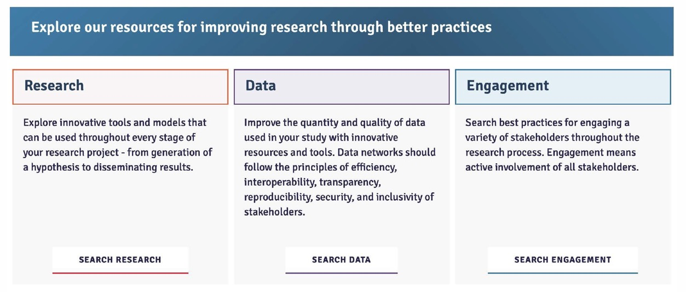

PCORnet Resources
Materials developed using PCORnet are shared to promote lessons learned and best practices in the Knowledge Repository located in the Resources section of PCORnet.org.
Resources are sorted by Research, Data, and Engagement and searchable by keyword. They include engagement case studies, lay audience glossaries, the PCORnet® Common Data Model, and more.
22

Slide 23

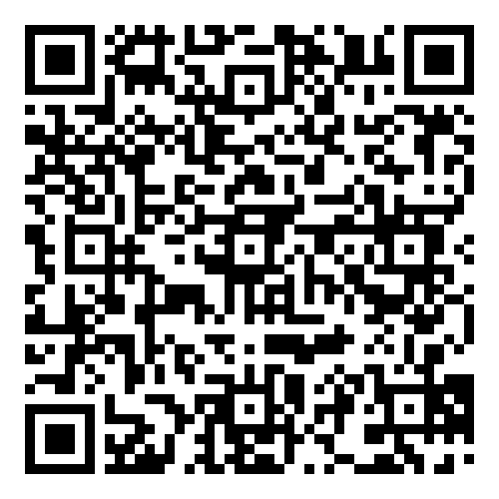


Connect with PCORnet
SUBSCRIBE to the PCORnet newsletter
Follow PCORnetwork on
Follow @PCORnetwork on
23

Slide 24
Appendix

Slide 25

How Are Data Linked While Being Kept Secure?
Common Data Linkage
Through strategic collaboration, PCORnet® Network Partners worked to establish a secure and standardized privacy-preserving record linkage (PPRL) infrastructure that is reusable and scalable
Each PCORnet network site uses software that converts data into de-identified tokens that can be securely shared with the Coordinating Center for PCORnet®
The tokens are included in a table that is associated with the PCORnet® Common Data Model
From there, the Coordinating Center uses a matching software to determine whether a patient’s data exists at more than one site (duplicative data)

Slide 26
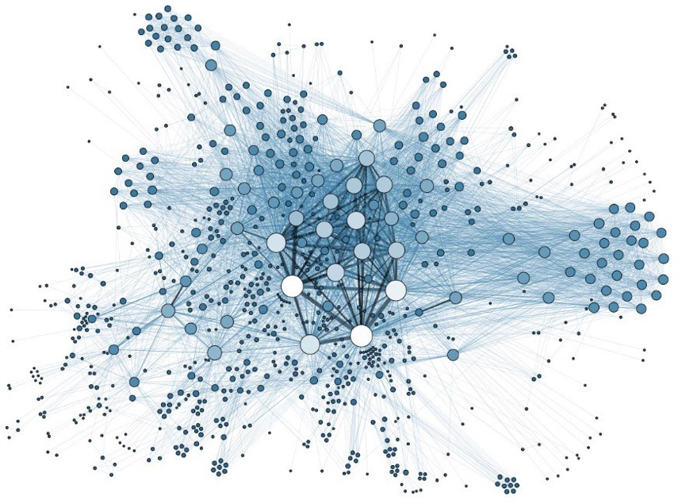
What Types of Data Have PCORnet® Network Partners Linked Using PPRL?
Claims data
Data included in health registries
Data that has been duplicated across healthcare systems

Slide 27
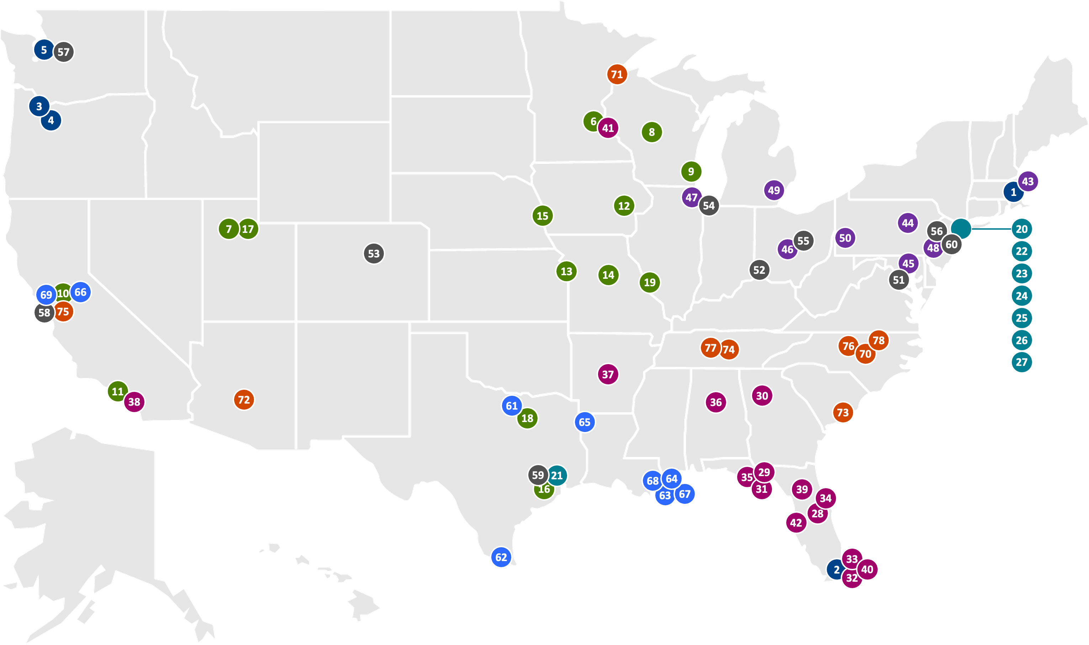
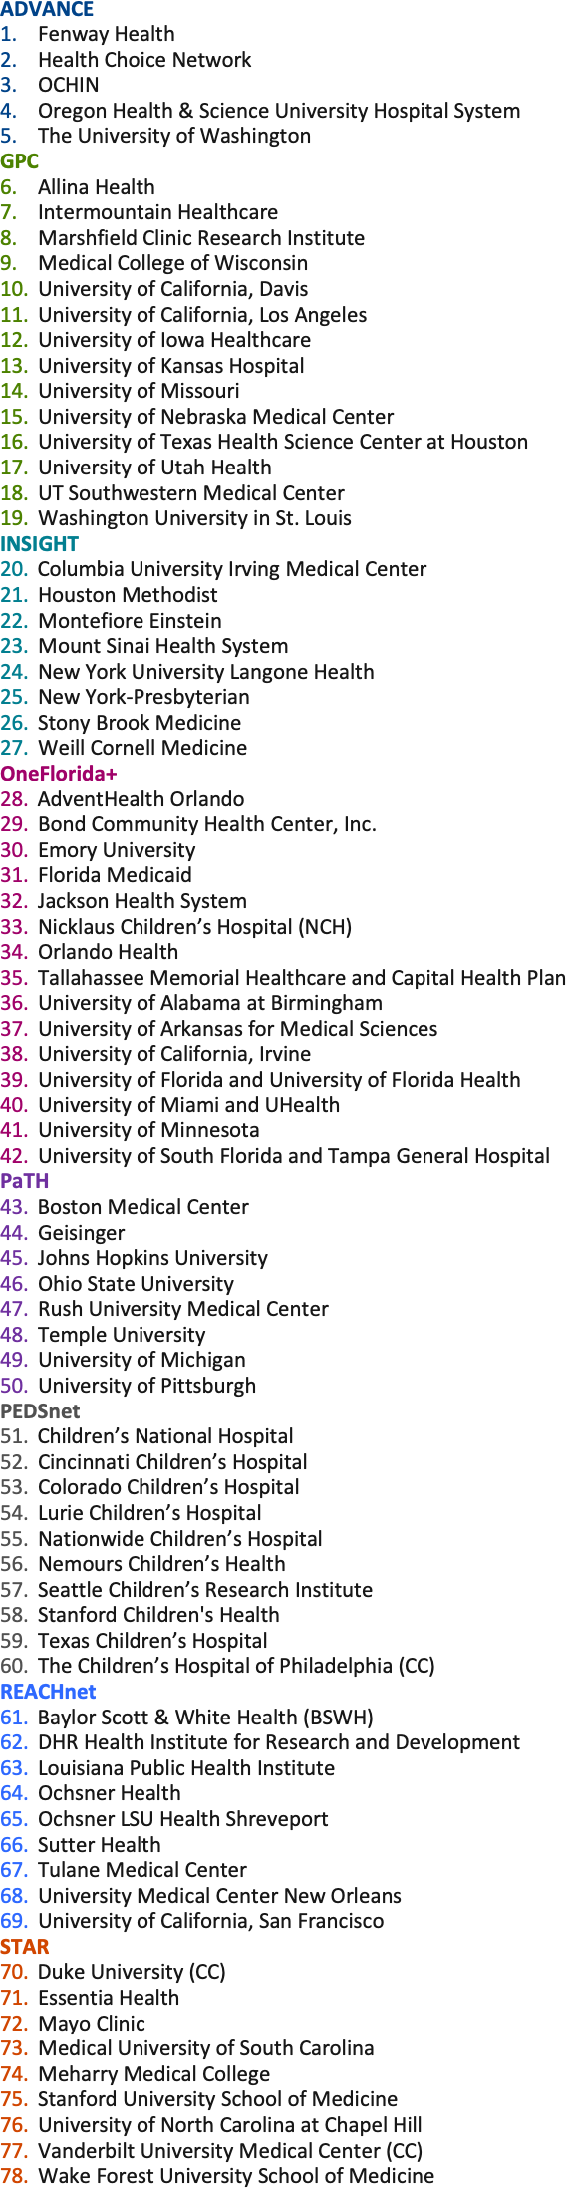
PCORnet® Clinical Research Network Locations
27

Slide 28
PCORnet® Clinical Research Network Locations
28

Slide 29
PCORnet® Clinical Research Network Locations
ADVANCE
Fenway Health
Health Choice Network
OCHIN
Oregon Health & Science University Hospital System
The University of Washington
GPC
Allina Health
Intermountain Healthcare
Marshfield Clinic Research Institute
Medical College of Wisconsin
University of California, Davis
University of California, Los Angeles
University of Iowa Healthcare
University of Kansas Hospital
University of Missouri
University of Nebraska Medical Center
University of Texas Health Science Center at Houston
University of Utah Health
UT Southwestern Medical Center
Washington University in St. Louis
INSIGHT
Columbia University Irving Medical Center
Houston Methodist
Montefiore Einstein
Mount Sinai Health System
New York University Langone Health
New York-Presbyterian
Stony Brook Medicine
Weill Cornell Medicine
OneFlorida+
AdventHealth Orlando
Bond Community Health Center, Inc.
Emory University
Florida Medicaid
Jackson Health System
Nicklaus Children’s Hospital (NCH)
Orlando Health
Tallahassee Memorial Healthcare and Capital Health Plan
University of Alabama at Birmingham
University of Arkansas for Medical Sciences
University of California, Irvine
University of Florida and University of Florida Health
University of Miami and UHealth
University of Minnesota
University of South Florida and Tampa General Hospital
PaTH
Boston Medical Center
Geisinger
Johns Hopkins University
Ohio State University
Rush University Medical Center
Temple University
University of Michigan
University of Pittsburgh
PEDSnet
Children’s National Hospital
Cincinnati Children’s Hospital
Colorado Children’s Hospital
Lurie Children’s Hospital
Nationwide Children’s Hospital
Nemours Children’s Health
Seattle Children’s Research Institute
Stanford Children's Health
Texas Children’s Hospital
The Children’s Hospital of Philadelphia (CC)
REACHnet
Baylor Scott & White Health (BSWH)
DHR Health Institute for Research and Development
Louisiana Public Health Institute
Ochsner Health
Ochsner LSU Health Shreveport
Sutter Health
Tulane Medical Center
University Medical Center New Orleans
University of California, San Francisco
STAR
Duke University (CC)
Essentia Health
Mayo Clinic
Medical University of South Carolina
Meharry Medical College
Stanford University School of Medicine
University of North Carolina at Chapel Hill
Vanderbilt University Medical Center (CC)
Wake Forest University School of Medicine
29

Slide 30
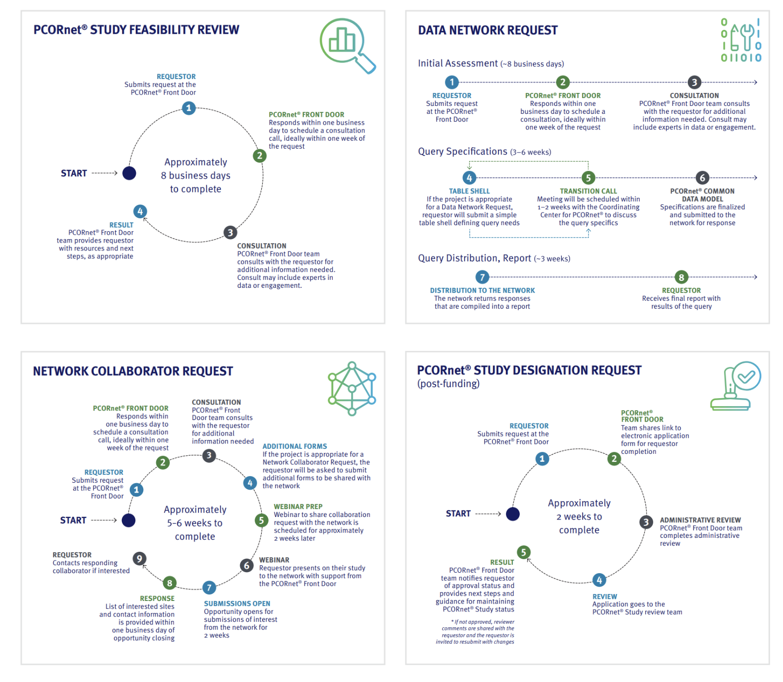
The PCORnet® Front Door
Learn more at PCORnet.org/ front-door

